Slide 1
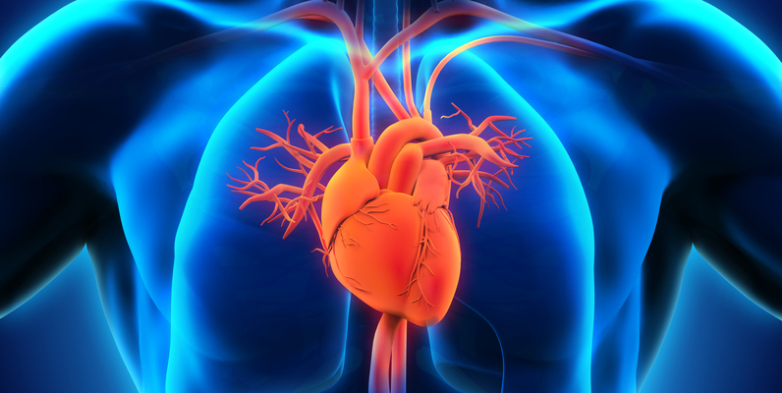

Project Title :- Heart Disease Prediction using Machine Learning
Presented By
Anagha Chandole
Keertiprada Vaidya
Saloni Nagdeve
Vishal Kurve
Under the Guidance of
Prof. Sandip Desai

Slide 2

Contents
Introduction
Literature Review
Problem Statement
Project Categories
Methodology Overview
Algorithms to be used
Work Done So Far
Future Work
References

Slide 3
Literature Review
Sr.No | Research Paper Tittle | Authors | Study
1 | Effective Heart Disease Prediction Using Hybrid Machine Learning Techniques | SENTHILKUMAR MOHAN, CHANDRASEGAR THIRUMALAI AND GAUTAM SRIVASTAVA | he main objective of this research paper is to summarize the recent research with comparative results that has been done on heart disease prediction and also make analytical conclusions. From the study, it is observed Naive Bayes with Genetic algorithm; Decision Trees and Artificial Neural Networks techniques improve the accuracy of the heart disease prediction system in different scenarios.
2 | Cardiovascular Disease Prediction Using Machine Learning Approaches | Taminul Islam,Mahadi Hasan | In this paper, data was collected from 1189 patients with some attributes related to heart disease and kept 80% data for training, and 20% data for testing and determining their accuracy using different models
3 | Heart disease prediction using support vector machine | Balakrishnan Duraisamy | In this paper, utilizing SVM as a machine learning algorithm to predict the likelihood of an individual having heart disease based on their consultation information provided online.

Slide 4

Project Categories
Multidisciplinary: Combines Machine learning, Data Science, Medicine and Statistics.

Slide 5
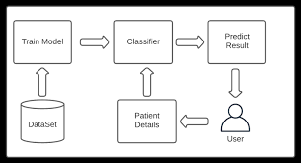
Methodology Overview
Steps:
Details Upload: Uploading all the necessary details of the Patient.
Disease Prediction: Use the Machine Learning Algorithm to find out the Chances of Heart Disease to the Patient.
Showcasing the Results: Show whether the Person has Risk of Heart Failure or not.

Slide 6
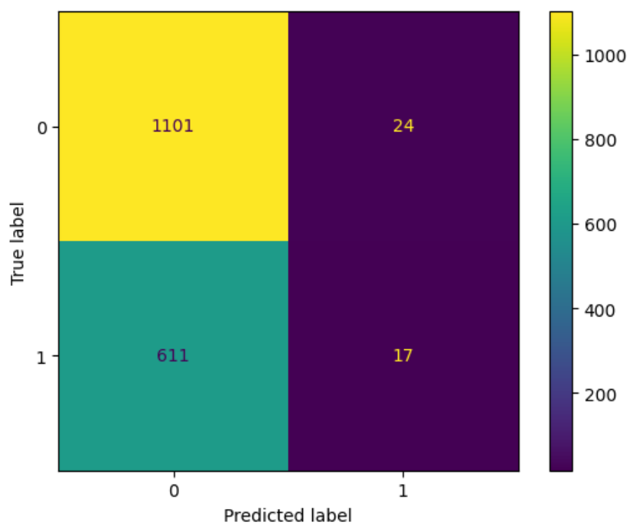
Classification Machine Learning Algorithm
What It Does:
Classifies Heart Failure : Identifies whether a patient is at risk of heart failure or not.
Training: Utilizes patient data, including features such as age, blood pressure, cholesterol levels, etc., to train the model.
Fast and Reliable: Provides quick and accurate predictions on the likelihood of heart failure based on the trained data.
Confusion Matrix

Slide 7

Problem Statement:
The dataset is from an ongoing cardiovascular study on residents of the town of Framingham, Massachusetts.
The classification goal is to predict whether the patient has a 10-year risk of future coronary heart disease(CHD).
The dataset provides the patients’ information. It includes over 4,000 records and 15 attributes. Variable Each attribute is a potential risk factor. There are both demographic, behavioral, and medical risk factors.

Slide 8
Data description:
Demographic:
Sex: male or female("M" or "F")
Age: Age of the patient;(Continuous - Although the recorded ages have been truncated to whole numbers, the concept of age is continuous)
Behavioral
is_smoking: whether or not the patient is a current smoker ("YES" or "NO")
Cigs Per Day: the number of cigarettes that the person smoked on average in one day.(can be considered continuous as one can have any number of cigarettes, even half a cigarette.)
Medical( history)
BP Meds: whether or not the patient was on blood pressure medication (Nominal)
Prevalent Stroke: whether or not the patient had previously had a stroke (Nominal)
Prevalent Hyp: whether or not the patient was hypertensive (Nominal)
Diabetes: whether or not the patient had diabetes (Nominal) Medical(current)
Tot Chol: total cholesterol level (Continuous)
Sys BP: systolic blood pressure (Continuous)
Dia BP: diastolic blood pressure (Continuous)
BMI: Body Mass Index (Continuous)
Heart Rate: heart rate (Continuous - In medical research, variables such as heart rate though in fact discrete, yet are considered continuous because of large number of possible values.)
Glucose: glucose level (Continuous) Predict variable (desired target)

Slide 9
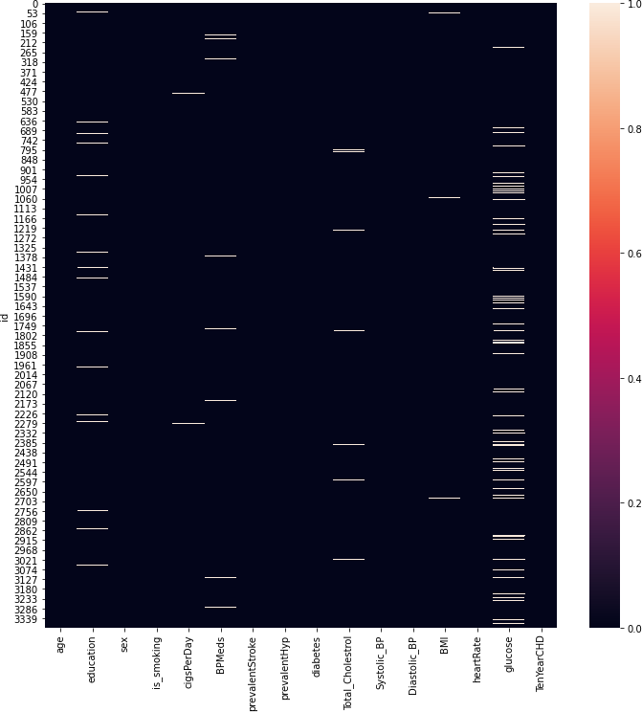
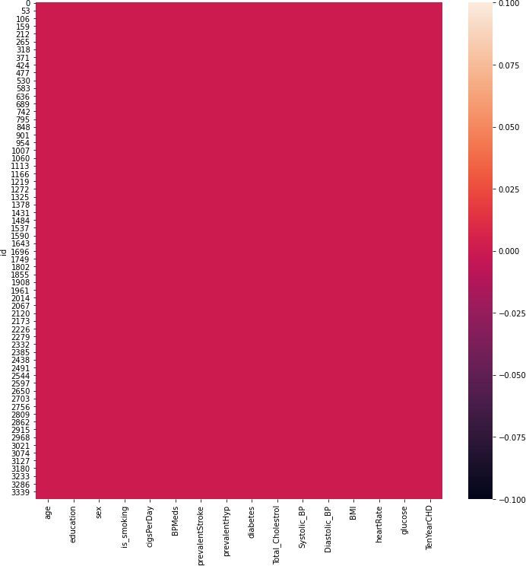
Missing Values & After filling NaN Values

Slide 10
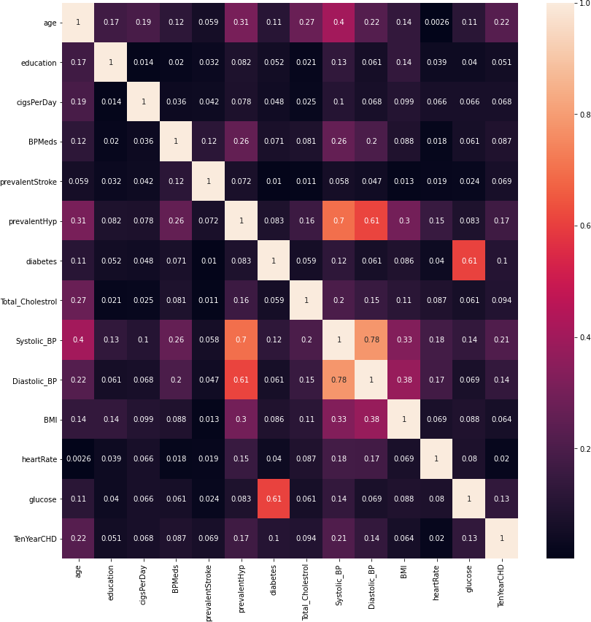
Correlation between features

Slide 11
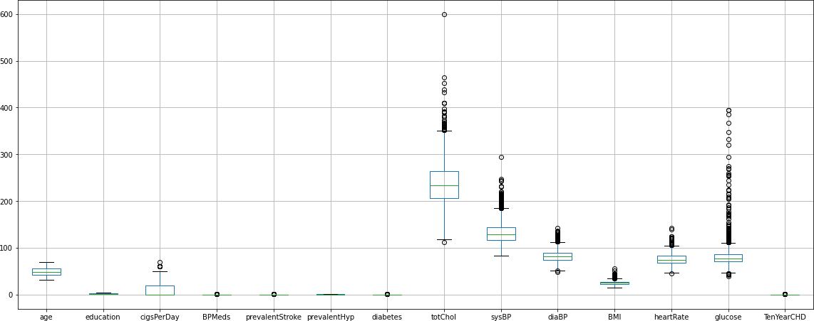
Outlier detection

Slide 12
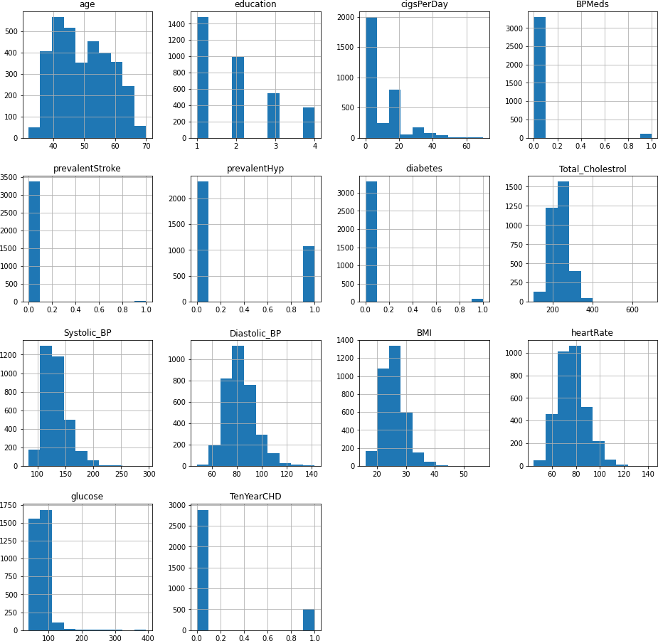
Distribution of data

Slide 13
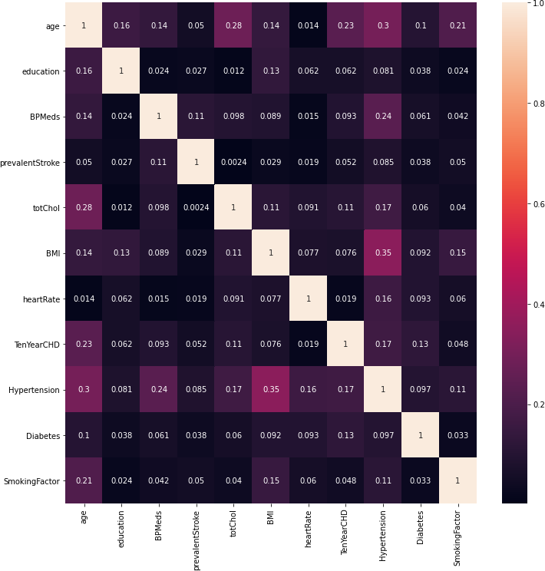
Correlation between features after feature engineering

Slide 14
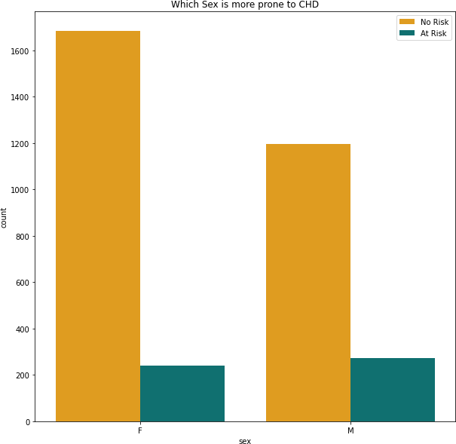
Which Sex is more prone to CHD ?

Slide 15
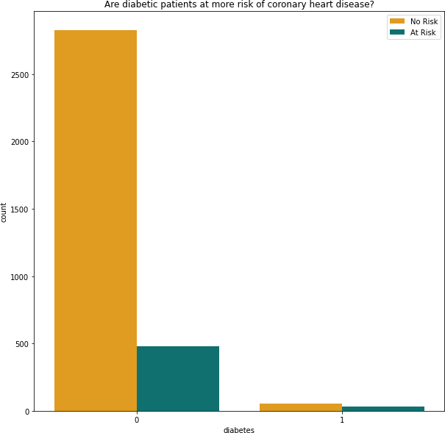
Are diabetic patients at more risk of chd ?

Slide 16
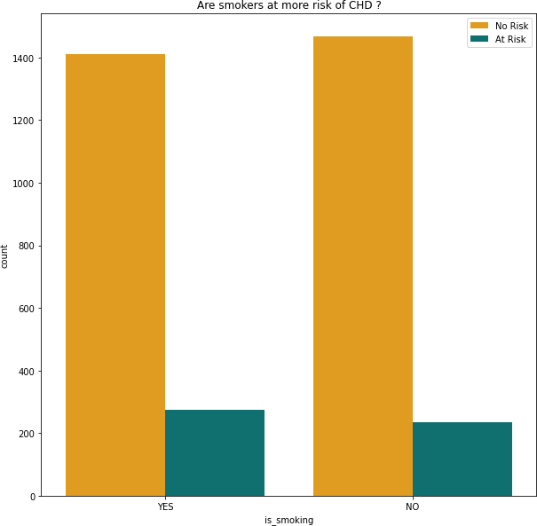
Are smokers at more risk of chd ?

Slide 17
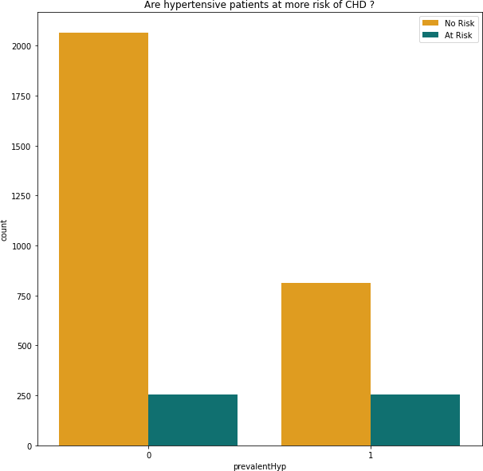
Are hypertensive patients at more risk of chd ?

Slide 18
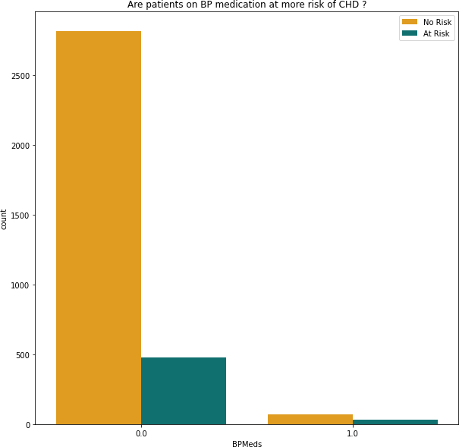
Are patients on bp medication at more risk of chd ?

Slide 19
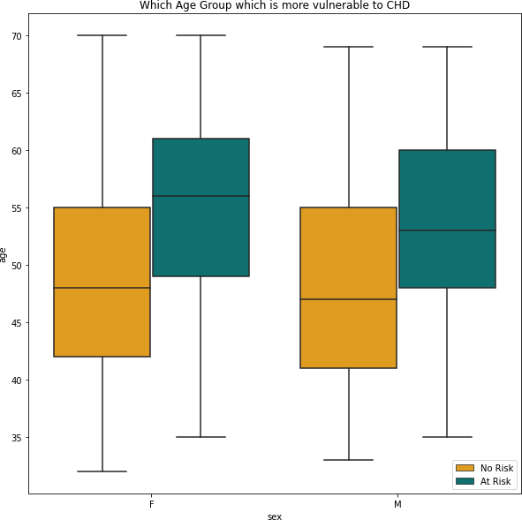
Which age group is more vulnerable to chd ?

Slide 20
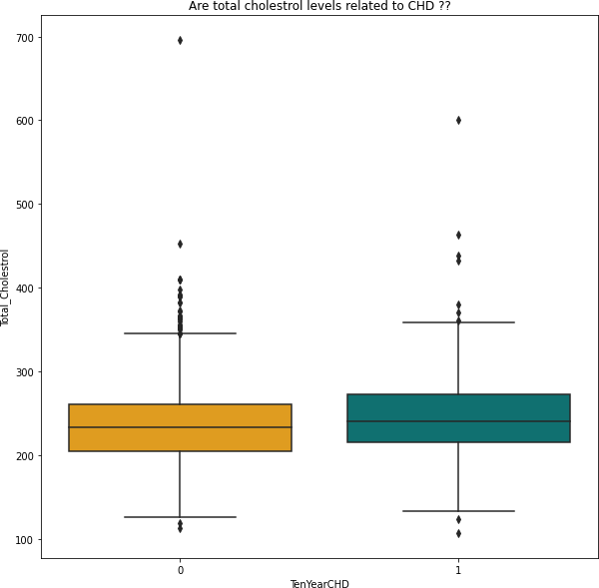
Are total cholesterol levels related to chd ?
This indicates that cholestrol level is not the sole deciding factor for predicting whether the person gets coron ary heart disease or not.
People with similar levels of cholestrol have got coronary heart disease as well as are free from coronary hea rt disease.
Clearly, there is no direct correlation of coronary heart disease with the cholestrol level.

Slide 21
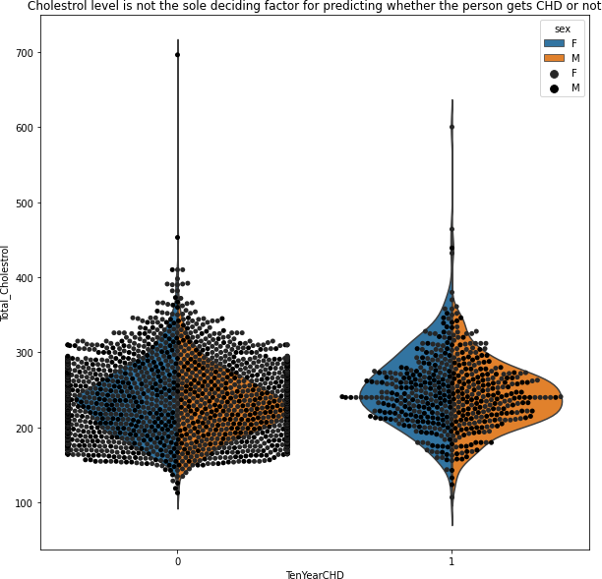
Cholestrol level is not the sole deciding factor for chd

Slide 22
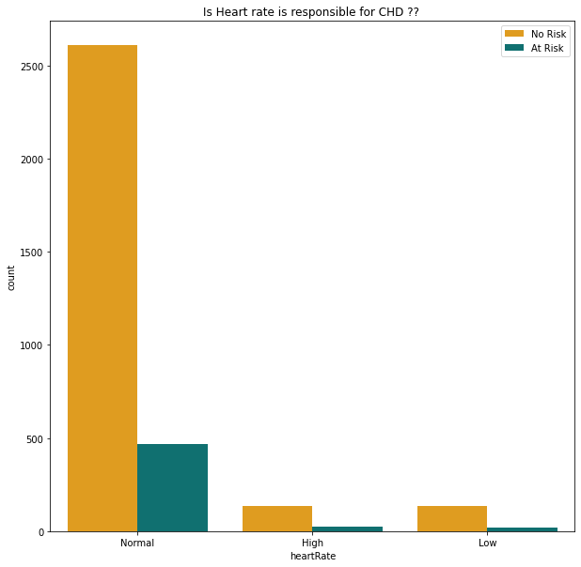
Can Heart rate possibly define the risk of chd ?

Slide 23
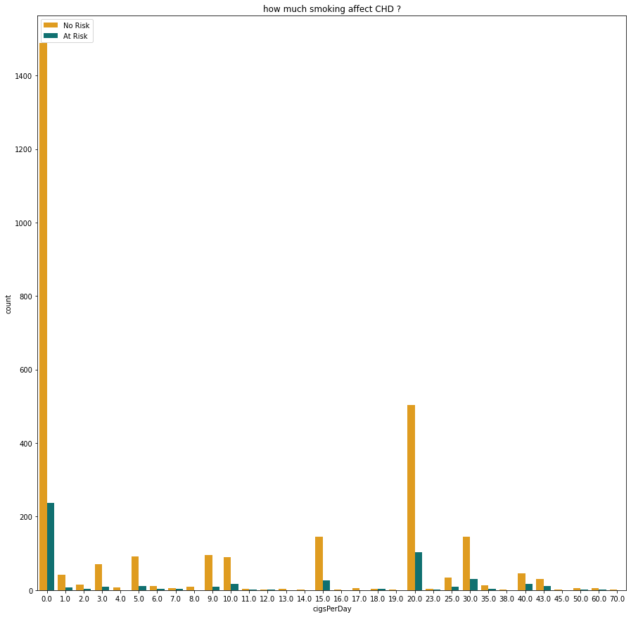
Can smoking number of cigarettes per day lead to chd?

Slide 24
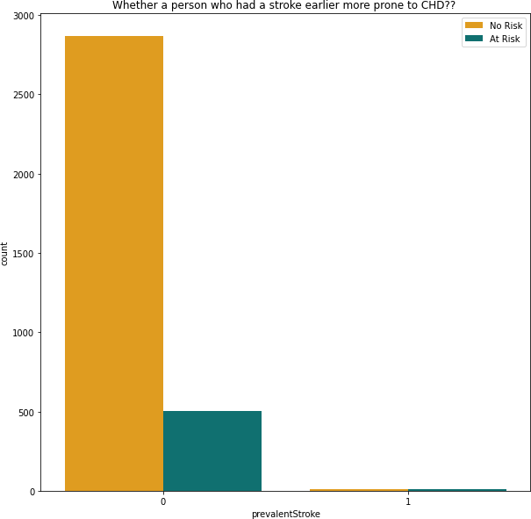
One who had a stroke earlier more prone to chd ?

Slide 25
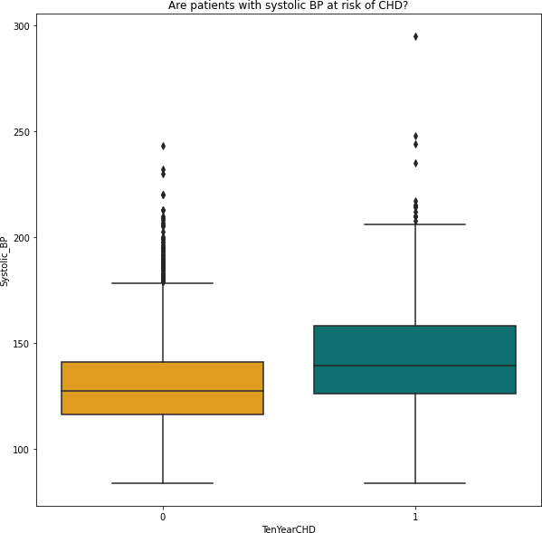
Are patients with systolic bp at risk of chd ?

Slide 26
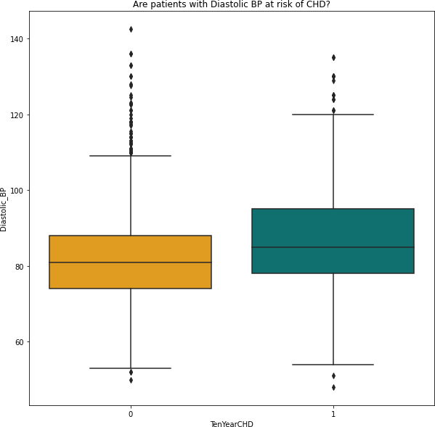
Are patients with diastolic bp at risk of chd ?

Slide 27
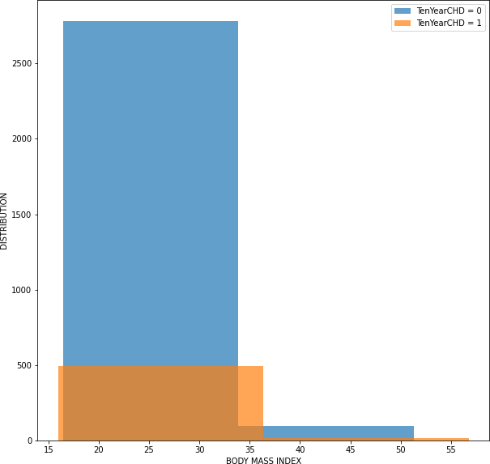
is patients bmi important to show the risk of chd ?

Slide 28
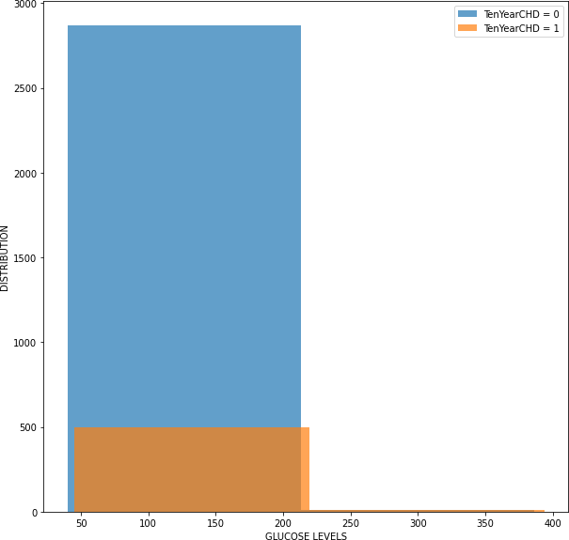
Can patients glucose levels show the risk of chd ?

Slide 29
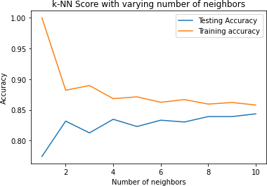
k-nn score with varying number of neighbors

Slide 30
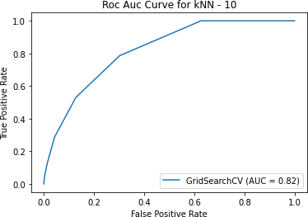
Roc auc curve for knn

Slide 31
The best fitting Model:-
Sr.no | ML Model | Test Accuracy Score | Train Accuracy Score
1 | Naive Bayes Classifier | 81 | 83
2 | KNN | 84 | 86
3 | Logistic Regression | 84 | 86
4 | Decision Tree | 75 | 76
5 | Random Forest | 89 | 99.8
6 | Gradient Boost | 87 | 90
7 | XGBoost | 97 | 83

Slide 32
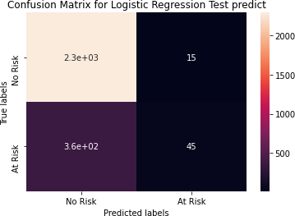
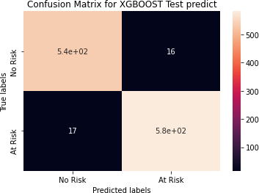
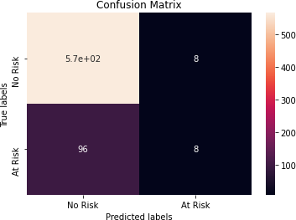
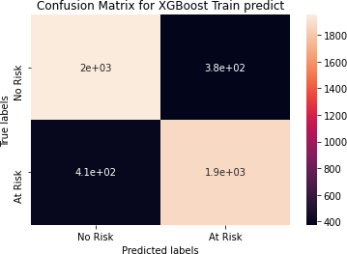
Confusion Matrix

Slide 33
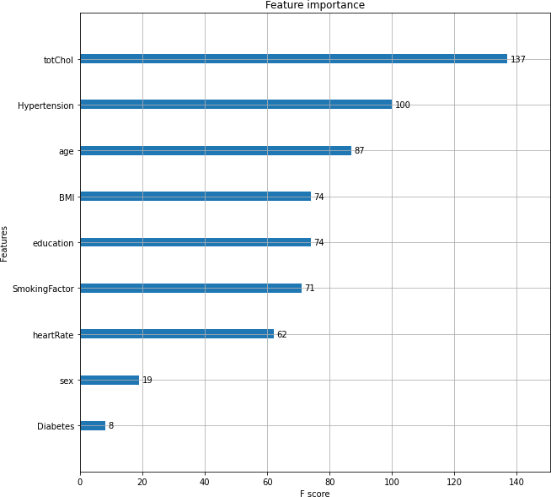
The Feature importance

Slide 34
Precision and Recall:-
The precision is the proportion of relevant results in the list of
all returned search results.
The recall is the ratio of the relevant results returned by the search engine to the total number of the relevant results that could have been returned.
In this project we are giving more importance to recall because predicting that the person doesn’t have a disease when he have one can risk that persons life.

Slide 35
challenges:
Less amount of data available made it difficult to predict properly.
Missing relevant/Important features in our dataset like Chest pain location, chest pain type, Family history of coronary artery, Exercise, etc.
The dataset was imbalanced and hence we were not able to apply
some models properly.

Slide 36
Conclusion:
A cardiovascular disease detection model has been built using no of ML
classification modelling techniques.
This project once deployed can possibly help predict the patients for cardiovascular disease based to their past medical history Blood pressure, Body mass index, Sugar levels etc.
The algorithms used in building the model are Logistic regression, Decision trees, KNN, Random forest classifier, Naive bayes classifier, Gradient boost and XGboost.
The top three models with best accuracy are Gradient boost, Random forest & XGboost with accuracy of 87%, 89%,and 97% respectively.

Slide 37
Conclusion:
And to conclude we started with loading the data. So far we have done EDA, null values treatment, encoding of categorical columns, feature selection and then model building.
In all of these models our accuracy revolves in the range of 75 to 97%. And there is no such improvement in accuracy score even after hyperparameter tuning.
Also it is concluded that accuracy of XGboost is highest as compared
to all the algorithms used i.e. 97%.
This performance could be due to various reasons like: No proper pattern of data, lack of data, not enough relevant features but maybe with enough data we can train our model even better.
●

Slide 38





References
Research Papers:-
1] Goutam Kumar Sahoo;Keerthana Kanike;Santos Kumar Das;Poonam Singh 2022 IEEE 32nd International Workshop on Machine Learning for Signal Processing (MLSP)
2] SENTHILKUMAR MOHAN 1 , CHANDRASEGAR THIRUMALAI1 , AND GAUTAM SRIVASTAVA 2,3, (Member, IEEE) 1School of Information Technology and Engineering, VIT University, Vellore 632015, India 2Department of Mathematics and Computer Science, Brandon University, Brandon, MB R7A 6A9, Canada 3Research Center for Interneural Computing, China Medical University, Taichung 40402, Taiwan
3] Konstantina Tsarapatsani;Antonis I. Sakellarios;Vasileios C. Pezoulas;Vassilis D. Tsakanikas;Marcus E. Kleber;Winfried März;Lampros K. Michalis;Dimitrios I. Fotiadis 2022 44th Annual International Conference of the IEEE Engineering in Medicine & Biology Society (EMBC)
Dataset:- Heart Attack Prediction Dataset
Dataset: https://www.kaggle.com/datasets/aasheesh200/framingham-heart-study-dataset.
Websites:-
Kaggle: http://kaggle.com/
IEEE Xplore: http://ieeexplore.ieee.org/
Google Scholar: https://scholar.google.com/

Slide 39
THANK YOU

